Slide 1
SRM UNIVERSITY AP
Department of Computer Science and Engineering
CSE 105 L

Slide 2
Project Report on
“Tourism Management System”
submitted in partial fulfillment for the award of the degree in
BACHELOR OF TECHNOLOGY
IN
COMPUTER SCIENCE AND ENGINEERING
Submitted by
Sai Dhanush,
Regd. Number: AP21110011214
Under the guidance of
Mrs. Pavithra B
Project Mentor

Slide 3
Abstract
Tourism Management System is a project which uses C programming language. The main objective of the project is to automate the process of tourism related works to minimize the manual work. The existing manual system is a tedious job where the details are stored in pen and paper mode. This is time taking and costly affair as it needs a lot of manpower with the increase in transaction the manual method became clumsier. With the increase of number of tourism packages, user cannot choose the package himself in a manual system, rather he has to depend on the tour operator. Moreover, the cancellation of ticket is also a cumbersome process in manual system. Hence, it needs a computerized system for proper and effective maintenance. The present C program related system provides the user to create an account with a password which gets stored in the tourism company’s database and can be used for log-in during future transactions. The system also provides information about available tourism packages both within the country and abroad to choose as per users’ choice. All other processes like, maintenance of the user transactions, cost evaluation and printing of tickets are done by the program. Project also provides an opportunity to the administrative team to go through all the bookings present in the soft form.

Slide 4
Introduction:
This project “TOURISM MANAGEMENT SYSTEM” is developed to automate the different procedures involved in travel and tourism processes.
The main modules include user registration, creation of a tour package, booking of travel and accommodation, confirmation and printing of tickets.
The various display pop-ups of the project and related program flow is developed using C code.
It is a package without any web linkages as our project is mostly restricted to the basic command set of C language included in our curriculum at this stage and is displayed in the C language console window only. Text files are used as back end to store the data.
The proposed system is designed to be more efficient than the existing manual system. It invokes all basic tasks that are now carried out manually, such as the forms transactions and reports which is added advantage.
The proposed System is completely computer-based application.

Slide 5
Objectives
The main objective of the project is to automate the process of tourism related works to minimize the manual work. The existing manual system is a tedious job where the details are stored in pen and paper mode. This is time taking and costly affair as it needs a lot of manpower with the increase in transaction the manual method became more clumsy . Hence, it needs a computerized system for proper and effective maintenance.

Slide 6
Advantages of the Proposed System:
Gives accurate information
Simplifies the manual work
It minimizes the documentation related work
Provides up to date information
Friendly Environment by providing warning messages
Booking confirmation
Notifications

Slide 7
System Requirements
SOFTWARE REQUIREMENTS:
The software requirements are description of features and functionalities of the target system.
Language used: C Language
Software: Dev C++
Text or Data files are saved in *.txt format using Notepad.
HARDWARE REQUIREMENTS:
Hardware requirements often specify the operating system version, processor type, memory size, available disk space and additional peripherals.
Operating System: Windows 7 (minimum)
RAM 4GB or above
Hard Disk: 1 TB (minimum)
Processor: i5/i7

Slide 8
System Design
Home page
User Registration
Package Creation
Package booking
Booking confirmation/manage
Issue ticket

Slide 9
Home Page
This module displays the user details on the top right corner.
Displays the modules available in the system.
Work flow is controlled as per user input, which includes an option for “logout” also.
All the modules can also be toggled to the “Home Page” as per user interaction.

Slide 10
User Registration
This module covers the details about the registration of users.
Users can register by themselves by adding data like name, password, email id and further details.
After registration they can be sign in by their username and password.

Slide 11
Package Creation
This module can create packages by creating package page.
User has to feed the details about:
Place of visit
Date and Period of Stay
Mode of travel
Type of accommodation
Number of people etc.

Slide 12
Package Booking
This module facilitates the booking based on user choices given in the creation module.
This module further informs the user/costumer about the cost of the tour package and other specific details related to the chosen tour.

Slide 13
Booking Confirmation/Manage
Booking confirmation is the process of confirming the booked packages by the travel agency.
Here the travel agency further confirms the cost of the tour and suggests for payment.
Different modes of payments are allowed as per user choice.
After confirmation of payment details from the concerned the work flow shifts to the ticket printing module else cancels the tour.

Slide 14
Issue Ticket
In this module the tickets of the confirmed packages can be printed.

Slide 15
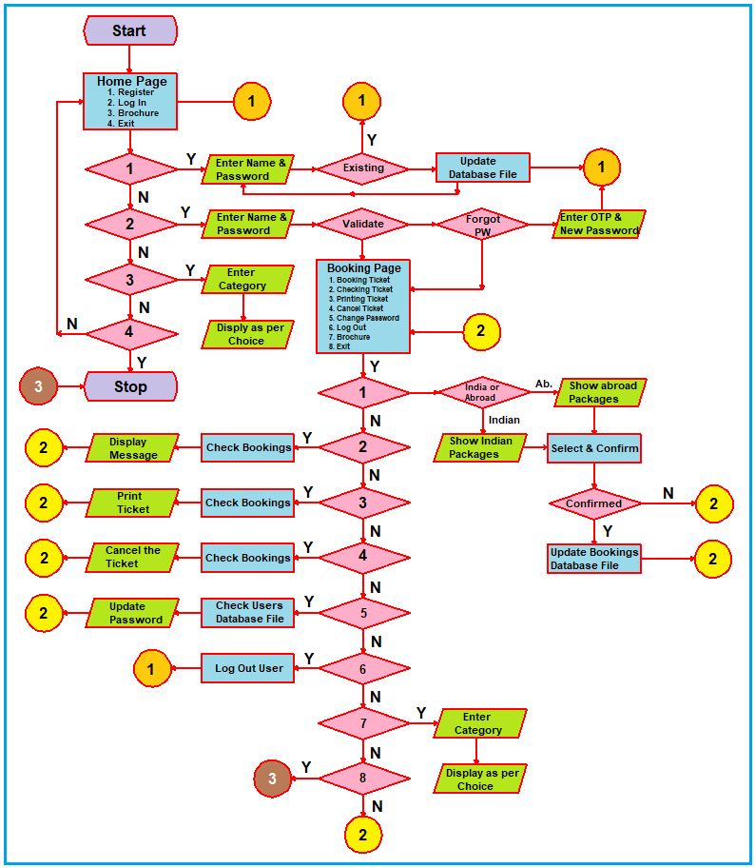
Flow Chart

Slide 16
Algorithm of the processing
START.
For new user go to registration else select login.
If ‘Forgot the Password’ go to ‘Change Password’ option else validate the user.
Upon changing the password, validate the user.
If ‘Valid’ go to selection of tour package.
Display all the available packages and their cost details.
User selects as per the availability, choice and cost.
Display the ‘Successful Booking’ status.
Display the ‘Print Ticket’ screen.
User ‘Previews or prints’ the ticket.
End.

Slide 17
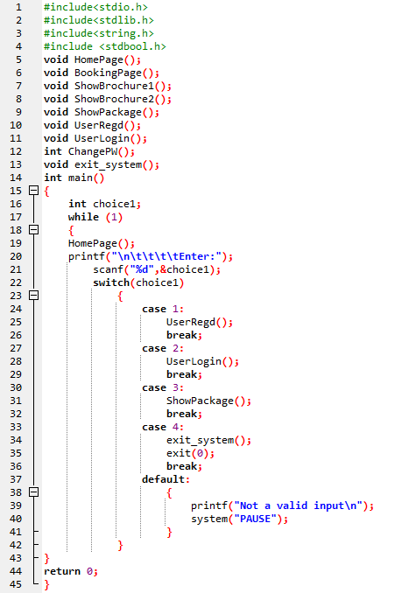
System Implementation
Home Page Creation

Slide 18
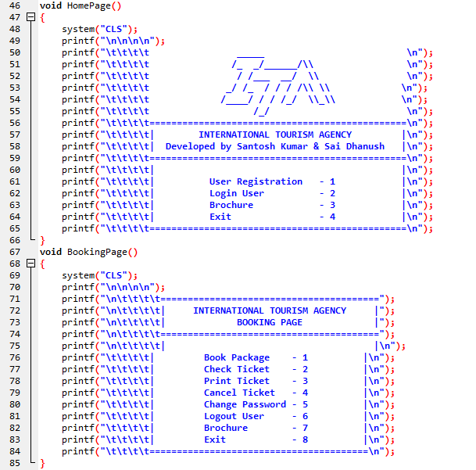
Home Page & Booking Page

Slide 19
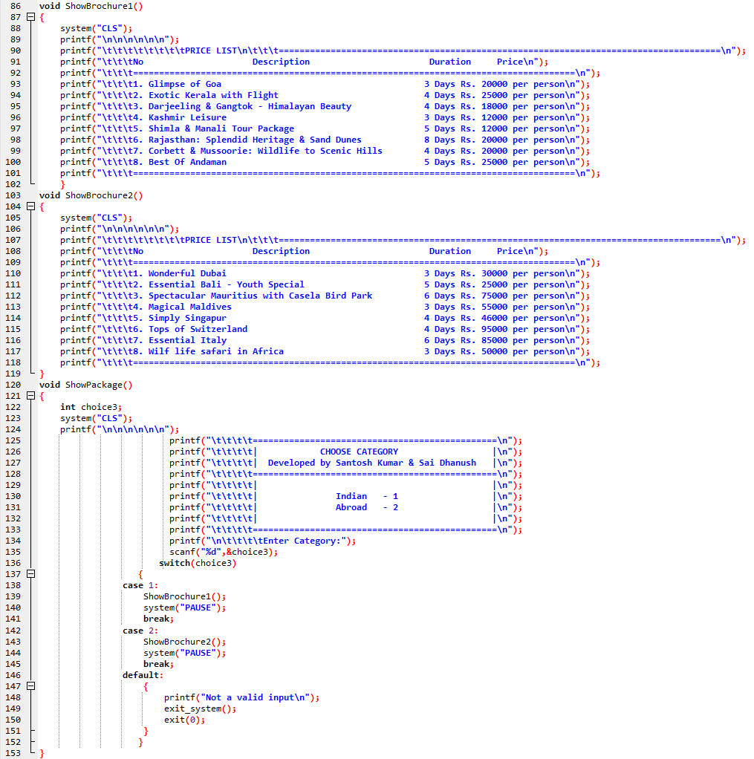
Brochure & Category Display

Slide 20
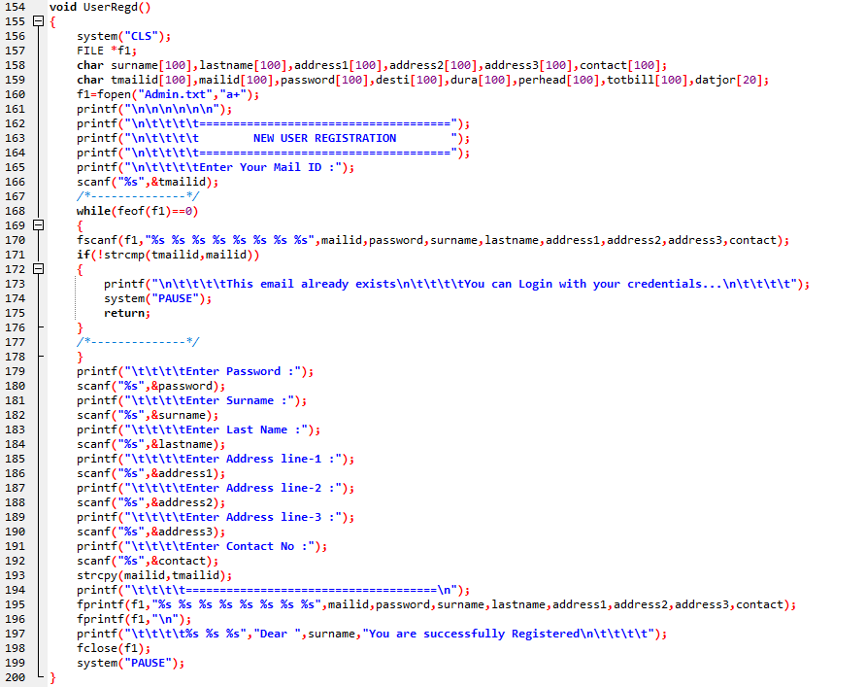
User Registration Page

Slide 21
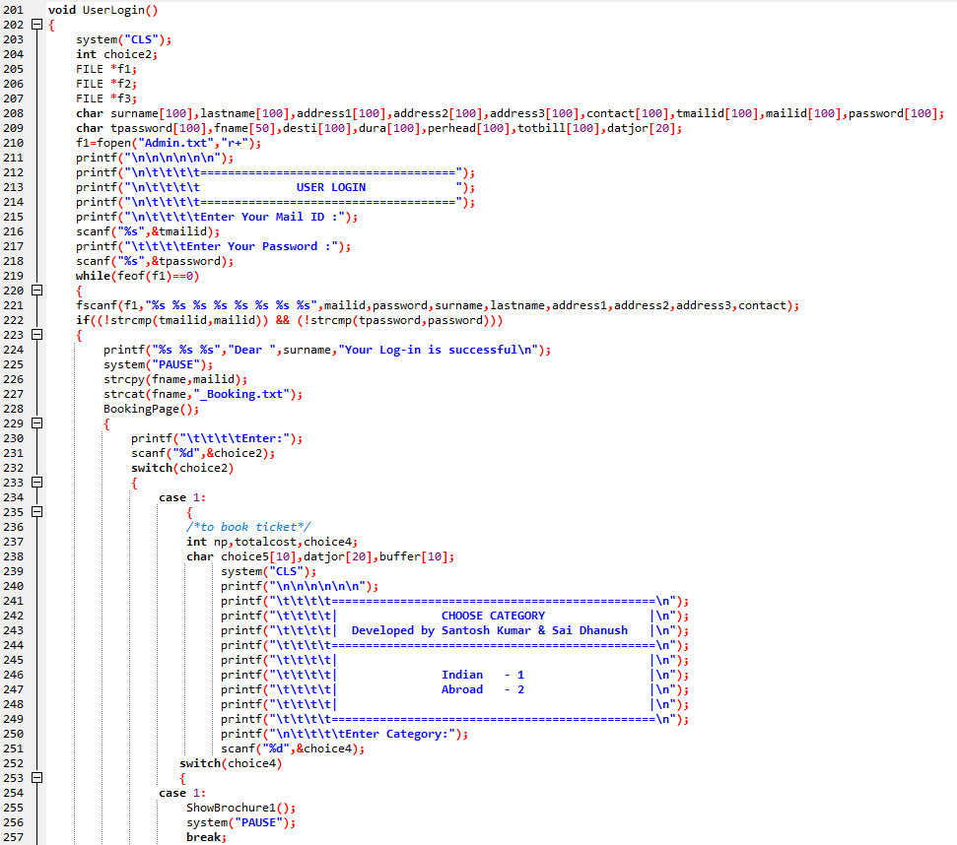
User Login & Category Selection

Slide 22
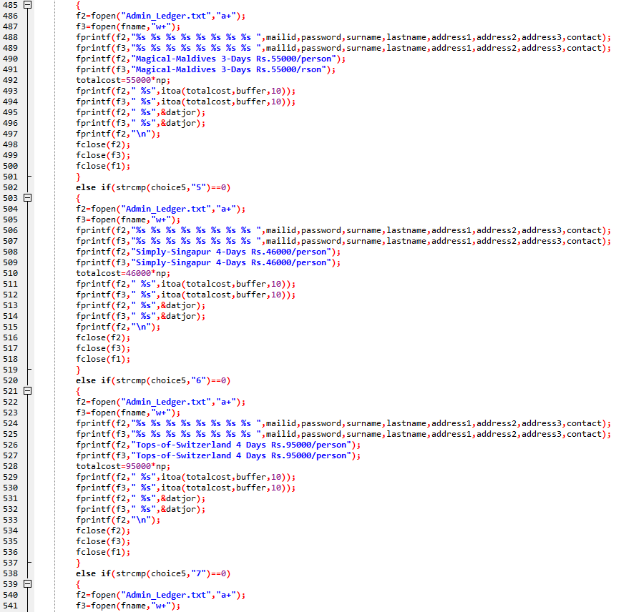
Tour Package Selection

Slide 23
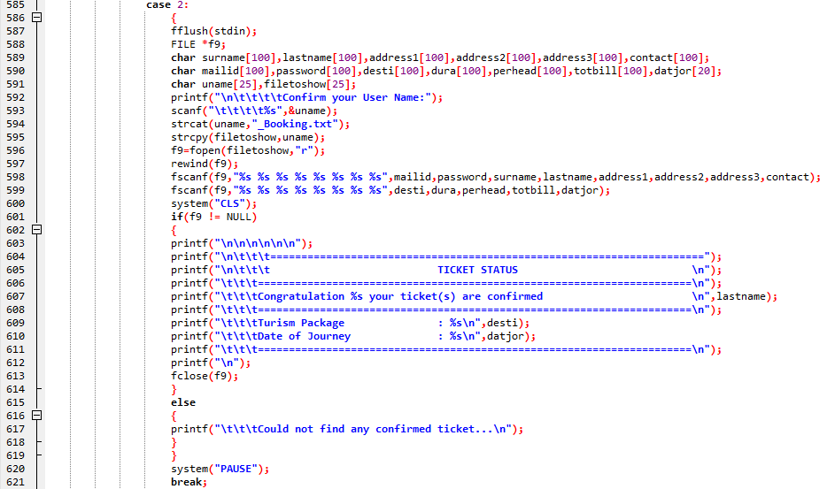
Checking Booking Status

Slide 24
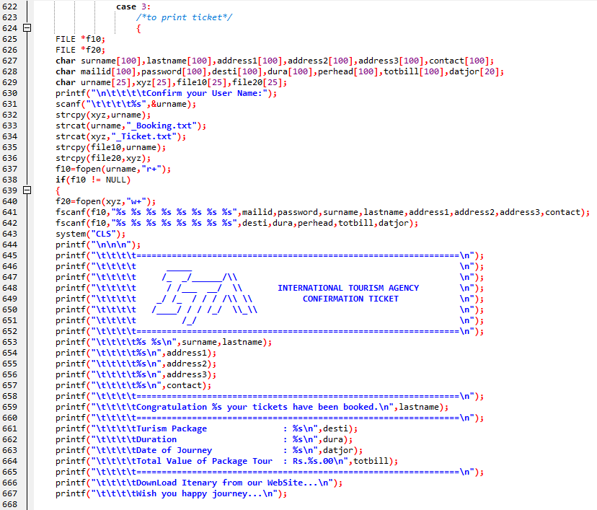
Printing of Confirmed Ticket

Slide 25
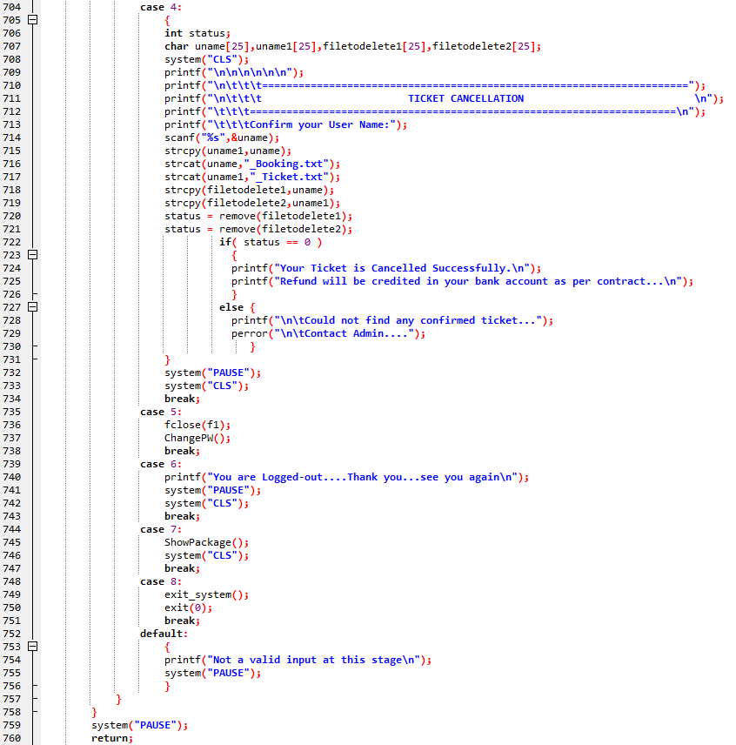
Cancellation of Ticket

Slide 26
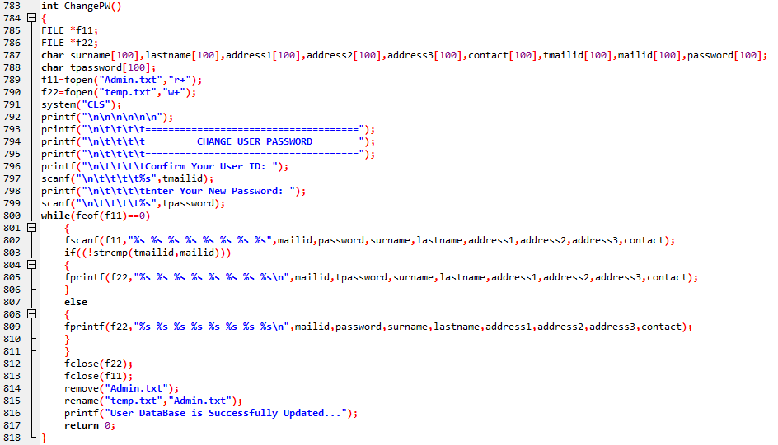
Change of Password

Slide 27
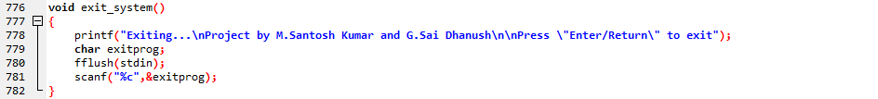
Exit System

Slide 28
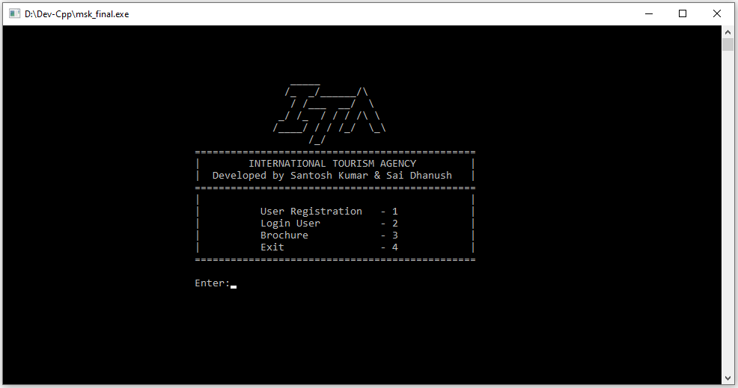
OUTPUT – HOME PAGE

Slide 29
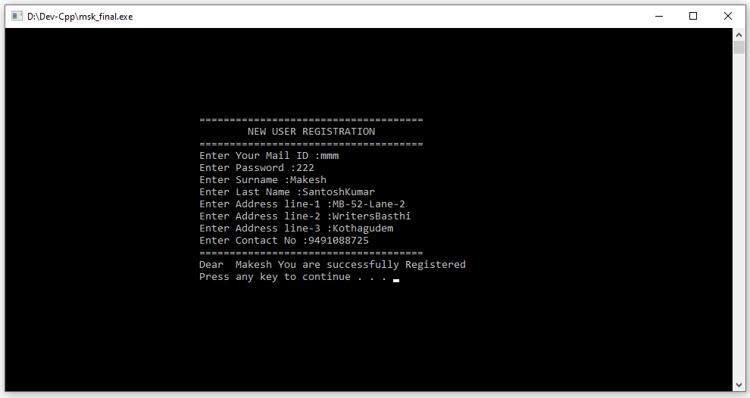
OUTPUT – NEW USER REGISTRATION

Slide 30
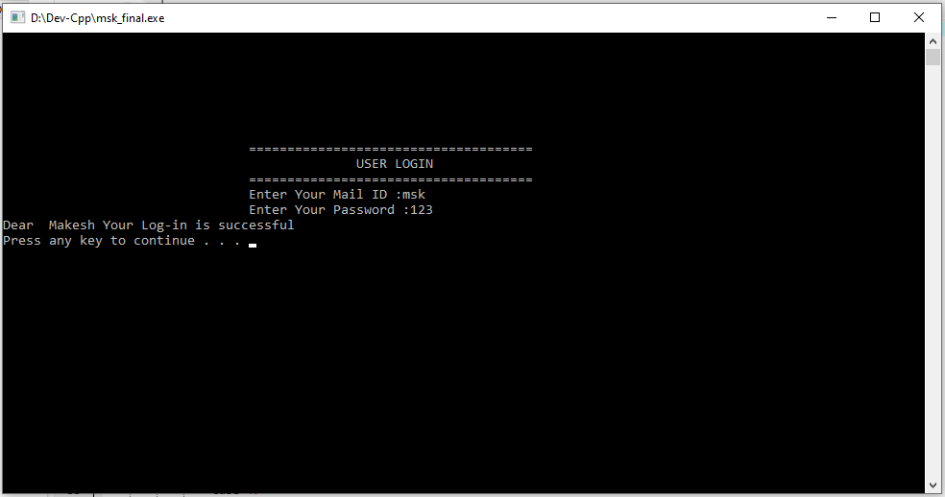
OUTPUT – USER LOGIN

Slide 31
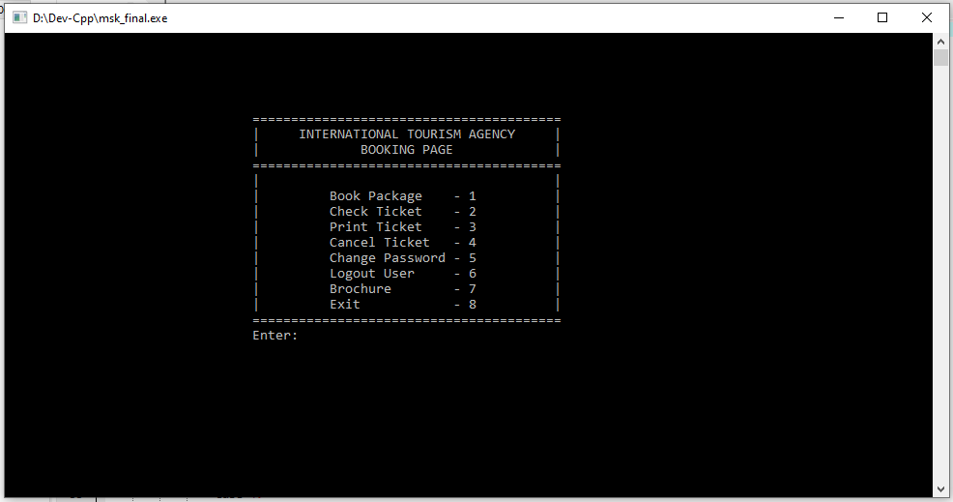
OUTPUT – BOOKING PAGE

Slide 32
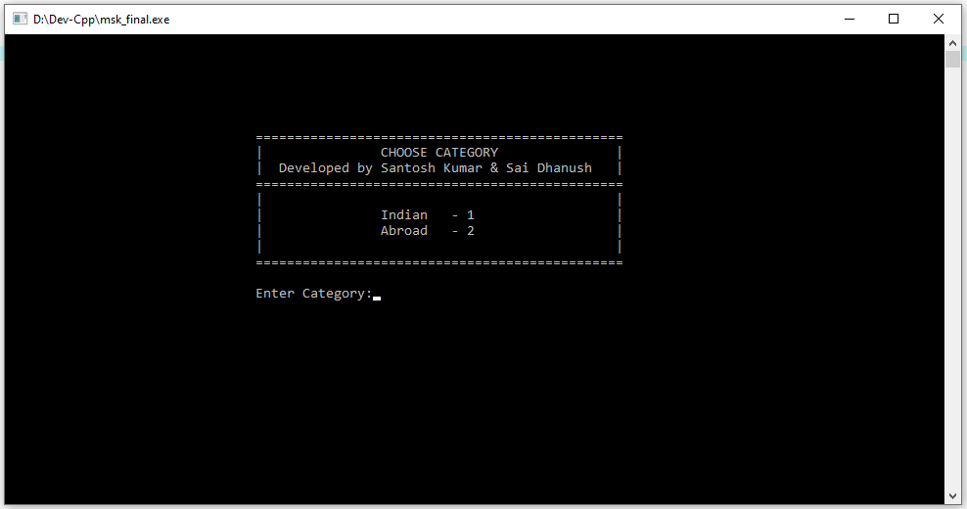
OUTPUT – CATEGORY SELECTION

Slide 33
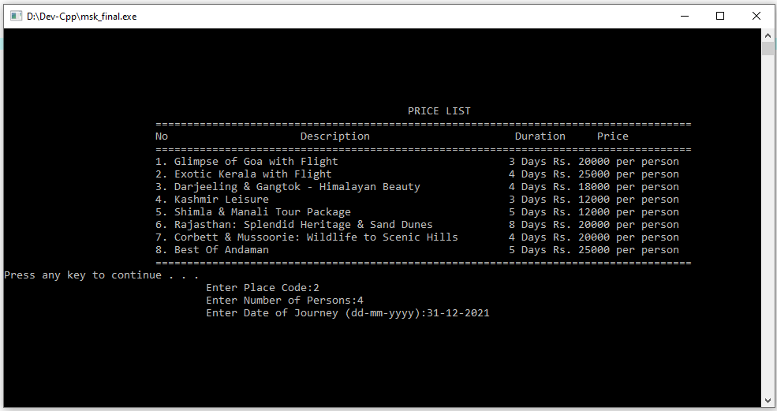
OUTPUT – WITHIN INDIA

Slide 34
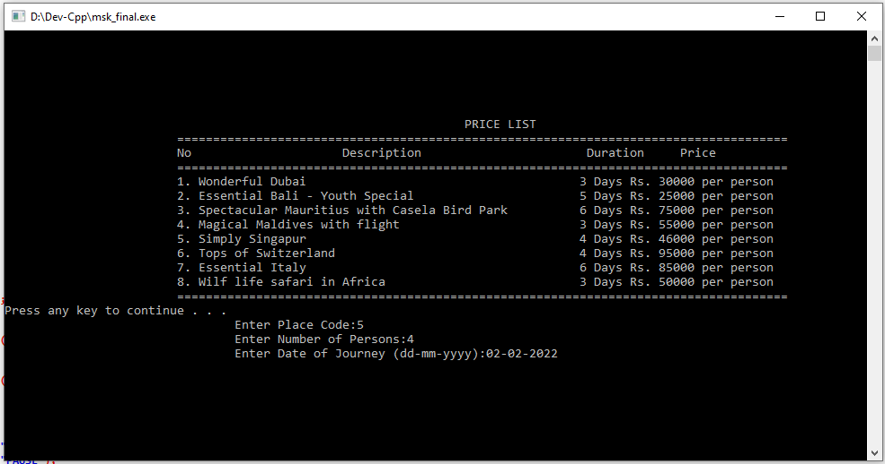
OUTPUT – PACKAGES ABROAD

Slide 35
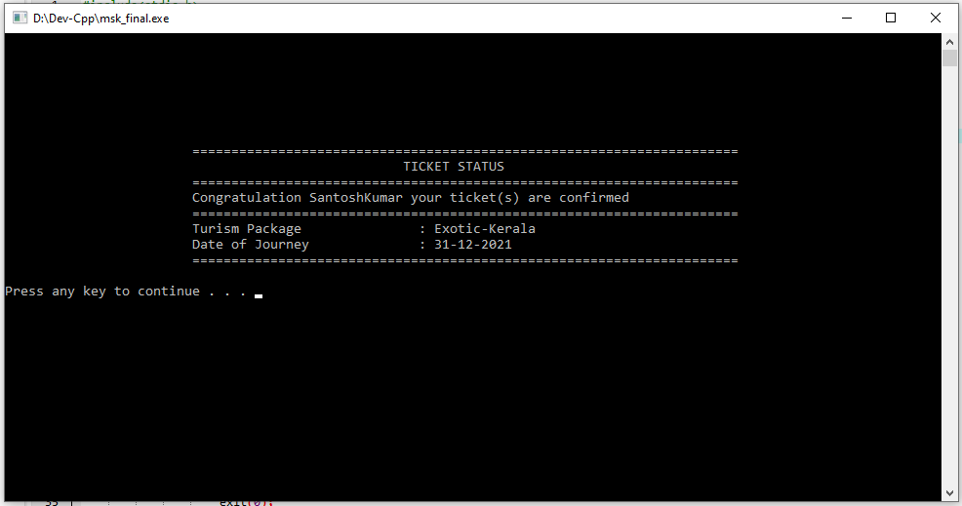
OUTPUT – CHECK TICKET

Slide 36
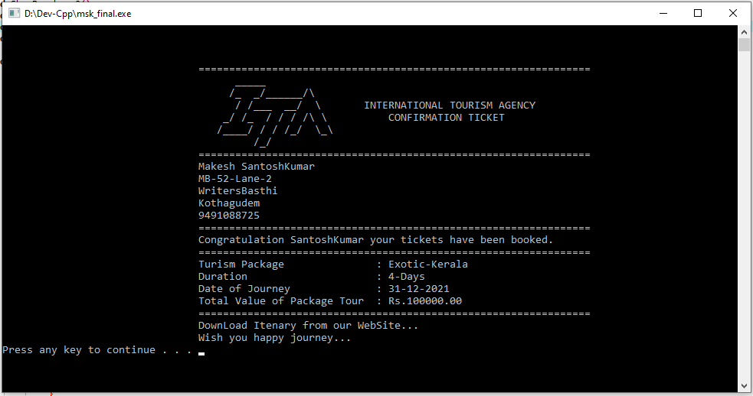
OUTPUT – PRINT TICKET

Slide 37
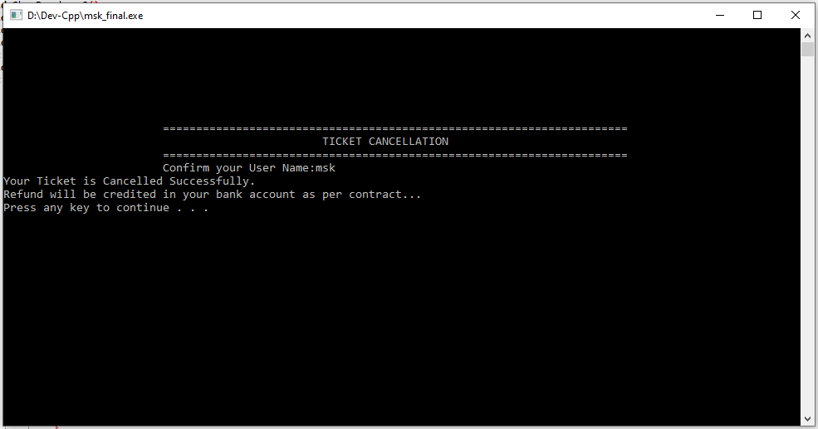
OUTPUT – TICKET CANCELLATION

Slide 38
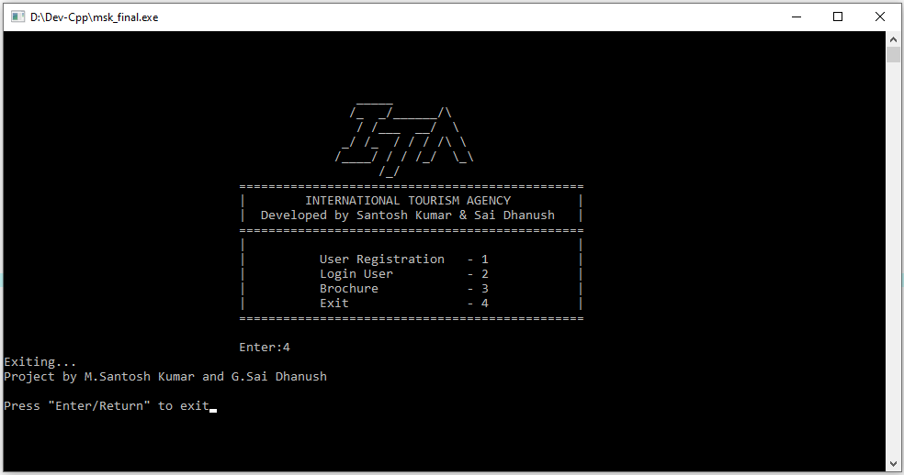
OUTPUT - Exit System

Slide 39
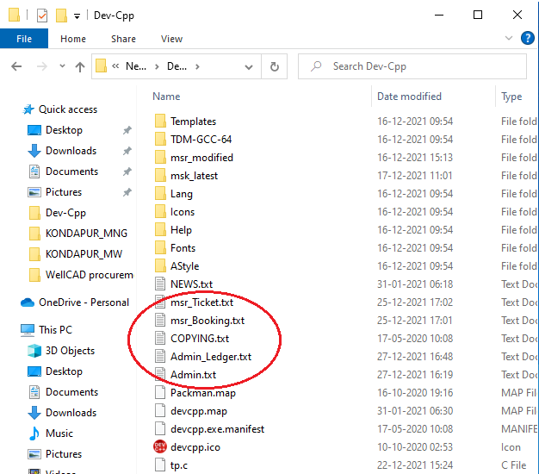
Data Files Created
Admin.txt – Appends all the newly registered users for further retrieval and use.
Admin_Ledger.txt – Appends all the new bookings of all users for further referencing and retrieval.
User_Booking.txt – Writes the latest booking of the user for further retrieval during status checking and printing.
User_Ticket.txt – Is the final ticket of the user. Upon cancellation of ticket the 3 & 4 txt files are removed, however, information is still retained in Admin_Ledger.

Slide 40
Thank You

